Slide 1
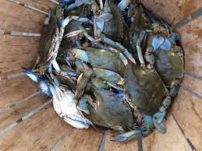
MARYLAND STATE PROGRAMMATIC GENERAL PERMIT (MDSPGP-6) TRAINING 28 SEPTEMBER 2021

Slide 2
Notable modifications
Revisions to Existing Activities and Conditions
New Activity
New Project Criteria Requiring Category B Review
New and Revised General Conditions
Changes to SOP
Notes:
So, what is knowledge management? It is the application of a structured process to help information and knowledge flow to the right people at the right time so they can act more efficiently and effectively to find, understand, share, and use knowledge to create value.
We need to gather the information and knowledge (both explicit knowledge which is written information or data and tacit knowledge which is knowledge/information/experience residing in the minds of individuals), develop a mechanism to share and store that information to other people, so that it can be utilized to make effective, timely, and efficient decisions.
The components of Knowledge Management are: People, Process, Tools, and Organization
Identifying people, creating a process, and using a tool to implement knowledge management are the tangible and easy components of knowledge management. Changing an organizational culture to a learning and sharing culture is the more difficult component of knowledge management.

Slide 3
Revisions to existing activities and conditions

Slide 4
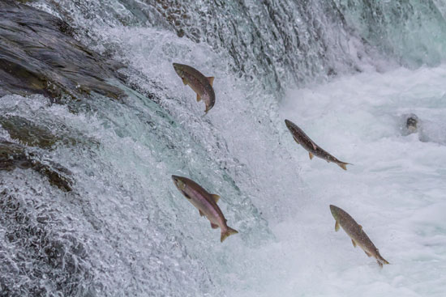
Editorial revisions
Certain activity specific conditions were relocated into general conditions due to their applicability across multiple activities. For example, anadromous fish species TOY restriction.
Repetitive language throughout the document was removed where appropriate for clarification and redundancy.
To streamline the MDSPGP-6, language discussing internal processes between agencies has been deleted.
Notes:
So, what is knowledge management? It is the application of a structured process to help information and knowledge flow to the right people at the right time so they can act more efficiently and effectively to find, understand, share, and use knowledge to create value.
We need to gather the information and knowledge (both explicit knowledge which is written information or data and tacit knowledge which is knowledge/information/experience residing in the minds of individuals), develop a mechanism to share and store that information to other people, so that it can be utilized to make effective, timely, and efficient decisions.
The components of Knowledge Management are: People, Process, Tools, and Organization
Identifying people, creating a process, and using a tool to implement knowledge management are the tangible and easy components of knowledge management. Changing an organizational culture to a learning and sharing culture is the more difficult component of knowledge management.

Slide 5
CATEGORY B Eligibility THRESHOLDS
MDSPGP-5 :
CAT B: Thresholds based on total temporary AND permanent impact.
For most activities, the total temporary and permanent impact to waters of the United States are not to exceed ½ acre and/or 2,000 linear feet of stream channel.
MDSPGP-6:
CAT B: Thresholds based on loss only, not total temporary and permanent impact.
For most activities, to be eligible for Cat B authorization, the single and complete project will result in no more than ½ acre of loss of tidal and nontidal waters of the United States, to include stream channel, wetlands, and open waters and the loss of stream channel may not exceed 1,000 linear feet.
Notes:
So, what is knowledge management? It is the application of a structured process to help information and knowledge flow to the right people at the right time so they can act more efficiently and effectively to find, understand, share, and use knowledge to create value.
We need to gather the information and knowledge (both explicit knowledge which is written information or data and tacit knowledge which is knowledge/information/experience residing in the minds of individuals), develop a mechanism to share and store that information to other people, so that it can be utilized to make effective, timely, and efficient decisions.
The components of Knowledge Management are: People, Process, Tools, and Organization
Identifying people, creating a process, and using a tool to implement knowledge management are the tangible and easy components of knowledge management. Changing an organizational culture to a learning and sharing culture is the more difficult component of knowledge management.

Slide 6
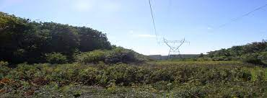
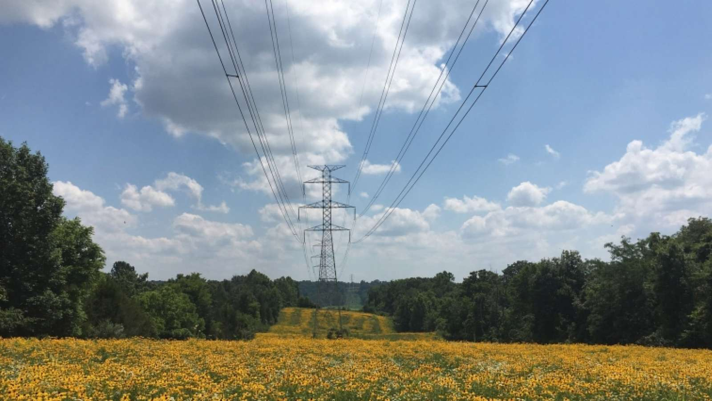
Permanent wetland conversion
MDSPGP-5:
Considered a temporary impact with a permanent loss of function when the site is restored to pre-existing contours; however, the vegetation type is permanently converted to another type. For example, PFO wetland permanently converted to PEM wetland to maintain utility line ROW. This type of permanent conversion DOES count toward CAT B eligibility thresholds as it is considered a temporary impact with a permanent loss of function.
MDSPGP-6:
Considered a temporary impact. WILL NOT count toward CAT B thresholds.
The Corps could require compensatory mitigation for loss of function as a result of a discharge of dredged or fill material.

Slide 7
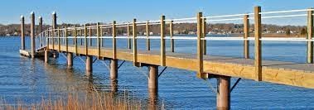
A(3) Piers
MDSPGP-5:
Individual floating piers
CAT A does not authorize individual floating piers.
Pier width over SAV
CAT A: Piers with 6-foot-wide decking that cross open waters must have their decking constructed a minimum of 4-feet above mean low water to minimize shading of Submerged Aquatic Vegetation (SAV). Alternatively, decking of a pier over open tidal waters must be constructed no lower than 3 feet above mean low water if the deck width does not exceed 5 feet.
MDSPGP-6:
Individual floating piers
CAT A does allow individual floating piers; however, no floating piers or auxiliary pier platforms shall be permitted in areas of mapped SAV shown on composite mapping of the five most recent years of verified SAV data (derived from VIMS aerial surveys).
Pier width over SAV
Cat A: No substantial change.
Notes:
Why is KM necessary? Some examples for the “why” to consider:
Information overload…how we get to what we need: Today the reality is that we are often sifting through too much information, rather than too little. What really matters? What is up-to-date vs outdated? How is it organized, can I access it easily?
How we keep information from getting lost: Information gets lost in a variety of ways from folks retiring without passing on their tacit knowledge, to things getting misfiled or mislabeled to catastrophic events.
How we maximize consistency: And when we can’t be consistent understand why those distinctions exist (e.g., regional conditions on NWPs that take into account specific differences in that region).
How we minimize duplication of effort:
How we capitalize on innovation: How do we structure knowledge management in a way that fosters innovation rather than suppresses innovation? How do we get great ideas out into circulation and change processes and procedures as a result?
Remove barriers to information transfer: Field office network inadequacies, perceived ownership, inappropriate restrictive permissions, perceived or real loss of control etc. are all barriers to information transfer. In some cases barriers are necessary, such as with sensitive draft or deliberative information and procedures to address these necessary barriers, without allowing them to become the de facto system, is necessary.
Taking these examples into consideration… In regulatory, Knowledge Management will generate value by improving decision making timeframes, address consistency issues, address the loss of the tacit knowledge of our regulators (i.e. when people retire), provide a consistent location for information, and remove barriers to information flow. This is important due to the dynamic nature of our program. It will enhance productivity and collaboration between our regulators.
The value KM provides is to create a culture of learning before, during, and after a project and share the explicit and tacit knowledge generated from each project within the organization to meet mission objectives.
Implementing knowledge management will generate a new thought process that it is everyone’s responsibility to share knowledge for the benefit of the organization and our Regulatory community.

Slide 8
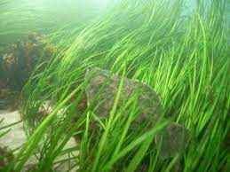
A(6) Mooring buoys
MDSPGP-5:
CAT A: No restriction on placing mooring buoys in SAV.
MDSPGP-6:
CAT A: No mooring buoy(s) will be placed in, or within 25 feet of, areas mapped by the Virginia Institute of Marine Science to contain SAV within the previous five years of verified data.

Slide 9
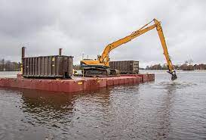
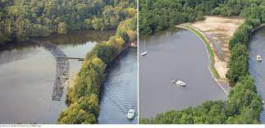
A(10) New tidal dredging
MDSPGP-5:
CAT B: Required all dredge material to be deposited into an upland site (no beneficial re-use).
MDSPGP-6:
CAT B: Does not require all dredge material to be deposited into an upland site (allows beneficial re-use if tested to be clean).
Dredged material may be disposed of at an approved upland disposal site or at an approved beneficial, re-use site, provided the Corps finds the dredged material to be suitable for such disposal.
The discharge of dredged material for beneficial re-use must be authorized under MDSPGP-6 Category B Activity f(2) Living Shorelines/Beach Nourishment or alternative Corps permit review process as appropriate.

Slide 10
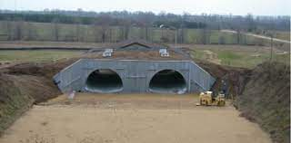
B(1) General maintenance
MDSPGP-5:
CAT A: Authorizes multiple culverts in a single perennial non-tidal channel.
Cat B: The total temporary and permanent impacts to WOTUS are not to exceed 1.0 acre and/or 2,000 linear feet of streams, rivers, and other open waters.
MDSPGP-6:
CAT A: Does not authorize more than one permanent culvert at a single location (side by side) in a single perennial non-tidal stream channel.
These projects will be reviewed on a project-specific basis under Cat B or alternate Corps permit review process.
Category B: No impact threshold.

Slide 11
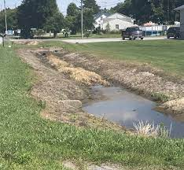
B(4) MAINTENANCE OF TIDAL ROADSIDE DITCHES
MDSPGP-5:
CAT B: The total temporary and permanent impacts to tidal ditches and tidal wetlands are not to exceed 1.0 acre and/or 2,000 linear feet of drainage ditch being maintained.
MDSPGP-6:
CAT B: No limit on maintenance dredging as long as the proposed dredge area does not exceed the dredging depths and footprint that was previously authorized.

Slide 12
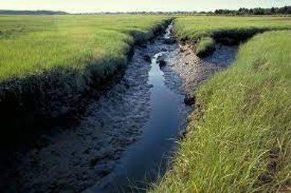
B(5) maintenance of Mosquito control ditches
MDSPGP-5:
CAT B: The total temporary and permanent impacts to tidal ditches and tidal wetlands are not to exceed 1.0 acre and/or 2,000 linear feet of drainage ditch being maintained.
MDSPGP-6:
CAT B: The single and complete project will result in no more than a total ½ acre loss of tidal waters of the United States, to include stream channel, wetlands, and open waters and the loss of stream channel may not exceed 1,000 linear feet.

Slide 13
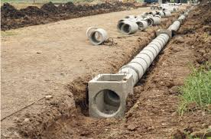
C(1) Utility lines
MDSPGP-5:
CAT B: The total temporary and permanent impacts to waters of the United States are not to exceed 1.0 acres and/or 2,000 linear feet of stream channel.
MDSPGP-6:
CAT B: This activity does not authorize any losses of waters of the United States. No limit on temporary impacts; however, temporary impacts must be reduced to the maximum extent practicable.

Slide 14
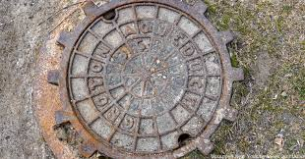
C(2) Foundations for Overhead Utility Line Towers, Poles, Anchors, and Minor Attendant Features for Subsurface Utility Lines
MDSPGP-5:
C(2) exclusively used for foundations for overhead utility line towers, poles, and anchors.
MDSPGP-6:
C(2) now includes minor attendant features for subsurface utility lines in tidal and nontidal areas.

Slide 15
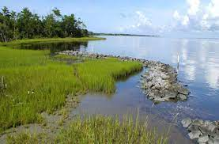
F(2) Living shorelines/beach nourishment
MDSPGP-5:
CAT A: No SAV or marsh impact.
CAT B: No SAV or marsh impact.
MDSPGP-6:
CAT A: No SAV impact. The total amount of vegetated wetlands which may be filled, graded, or excavated, in square feet, may not exceed 1 square foot per linear foot of the activity along the shoreline.
CAT B: No specific limit on SAV impact, however, impacts to SAV must be reduced to the maximum extent practicable. Tidal waters impact limited to ½ acre loss, but there can be no net loss of wetlands.

Slide 16
NEW ACTIVITY

Slide 17
e(11) Habitat restoration for Compensatory mitigation
MDSPGP-5:
Not present.
MDSPGP-6:
Activity to be used ONLY for compensatory mitigation that is required for projects authorized under the MDSPGP-6.
E(11) is NOT to be used for general restoration projects. The Corps would evaluate those projects under NWP-27 or the TMDL RGP.

Slide 18
NEW project criteria requiring cat B review

Slide 19
NEW project criteria requiring cat B review
A project that:
Involves temporary fill in place greater than one year
Does not meet culvert countersinking general condition requirements
Involves more than one (1) permanent culvert proposed to be installed at a single location (side by side) within a perennial non-tidal stream channel.
Includes proposed work located in an area encumbered by an existing site protection instrument such as a conservation easement, deed restriction, or declaration of restrictive covenants required as a condition of a prior Corps, MDE, or EPA authorization.

Slide 20
New and Revised General Conditions

Slide 21
general condition #16: Critical habitat
*NEW*
Any work proposed in designated or proposed critical habitat requires a case-by-case Category B review by the Corps. Current designated Critical Habitat within the State of Maryland includes:
Potomac River from the mouth of the Chesapeake Bay to the Little Falls Dam, including Breton Bay and St. Clements Bay;
Nanticoke River from the mouth of the Chesapeake Bay to the Route 313 bridge; and
Marshyhope Creek from the confluence with the Nanticoke River to the Route 318 bridge.

Slide 22
General condition #27: Designated critical resource waters
*NEW*
Any activity proposed in the designated National Estuarine Research Reserves, including wetlands adjacent to those waters must be reviewed by the Corps under a MDSPGP-6 Category B activity or other Department of the Army permit. The designated National Estuarine Research Reserves in Maryland are:
a. Jug Bay
b. Otter Point Creek
c. Monie Bay

Slide 23
General condition #29: mitigation standards
*REVISED*
Conversion of Aquatic Resources: Where certain functions and services of waters of the United States are permanently adversely affected by a regulated activity, such as discharges of dredged or fill material into waters of the United States that will convert a forested or scrub-shrub wetland in a permanently maintained utility line right-of-way, mitigation may be required to reduce the adverse environmental effects of the activity to the no more than minimal level.

Slide 24
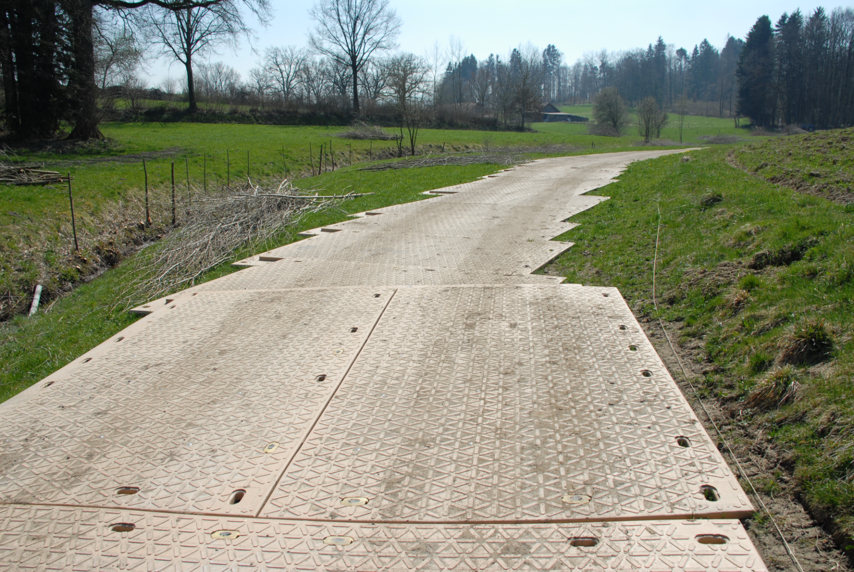
General condition #31: Removal of temporary Fill, structures, and mats
*REVISED*
Renamed to include the removal of structures
Now includes the following condition:
When temporary fills in waters of the United States will not be removed within the 12-month period, an application must be submitted, and the activity reviewed by the Corps under a Category B or alternate permit review process. Compensatory mitigation may be required to offset any adverse temporal effects.

Slide 25
General condition #34: depressing pipes and culverts
*NEW*
Culverted crossings of intermittent and perennial waterbodies must meet the following conditions:
Countersinking Pipes and Culverts: Culverts and bridge/arch footers must be countersunk to certain depths below the natural stream invert based on diameter.
Hydraulic opening: Culverts and pipes must be adequately sized to allow for passage of OHW with countersinking and invert restrictions taken into account.
Pipes and culverts on bedrock or above existing buried utility lines or pipes: If countersinking is not practicable due to bedrock or existing utility, additional documentation is required.
Extensions of existing pipes and culverts: Countersinking requirements do not apply to extensions of existing culverts or pipes.
When Category B review is required: When countersinking of the pipe or culvert is not practicable in accordance with the requirements above, an application should be submitted to the Corps.

Slide 26
General condition #35: Water crossings
*REVISED*
Category B review is now required for any new culvert installation or culvert replacement where more than one (1) permanent culvert is proposed to be installed at a single location (side by side) within a perennial non-tidal stream channel.
This condition does not apply to intermittent or ephemeral stream channels, temporary crossings, tidal crossings, or culverts installed in the floodplain.
A single culvert may not be placed in each stream braid within the same channel under CAT A.

Slide 27
General condition #38: Anadromous fish time-of-year restrictions
*NEW*
Condition applies to activities b(1), b(2), b(4), b(5), b(6), c(1), c(2), c(3), e(1), e(5), e(7), e(9), and f(4):
To ensure that activities do not impact spawning habitat or a migratory pathway for anadromous fish, all in-water work is prohibited during February 15 to June 15 each year to protect sensitive life states of anadromous fish in all tidal and nontidal coastal plain streams within the State of Maryland, and all piedmont streams in Harford and Cecil Counties, Maryland, unless specifically waived by the Corps in consultation with the National Marine Fisheries Service – Habitat and Ecosystem Services Division.
If compliance with this time of year restriction is not practicable, the applicant must request a waiver for this time of year restriction by submitting an application to MDE for Corps authorization under a Category B in coordination with the National Marine Fisheries Service – Habitat and Ecosystem Services Division. The application must include written supporting information, including all options considered, demonstrating that this condition cannot be practicably met.

Slide 28
General condition #39: beneficial reuse of dredged material
*NEW*
Applicant must identify the intent to use dredge material for fill activities within waters of the United States at the proposed placement site.
Applicants must provide the exact location and quantities of dredge material placement within waters of the United States to the Corps and MDE.
Material testing is required at the dredging and placement sites prior to placement and must comply with the Evaluation of Dredged Material Proposed for Discharge in waters of the United States-Testing Manual: Inland Testing Manual
At minimum, Tier 1 testing as outlined in Section 3.1 must be applied for all projects proposing beneficial reuse of dredge material within waters of the United States.
Any temporary storage of dredge material must be placed in uplands in accordance with federal, state, and local regulations.

Slide 29
General condition #44: poured concrete into forms
*NEW*
Activities that involve the discharge of poured concrete must be contained within cells or watertight forms until the concrete is set.

Slide 30
CHANGES TO SOP

Slide 31
Return procedure
MDSPGP-5:
Corps PM may return MDSPGP-6 applications to MDE that have been miscategorized. If MDE has already issued the permit, Corps must process.
MDSPGP-6:
No change.

Slide 32
401 WQC Procedure
MDSPGP-5:
MDE does not have ability to request individual WQC for certain activities.
MDSPGP-6:
MDE has 35 days from receipt of application to request individual WQC for specific activities (listed in 401 WQC).

Slide 33
Reauthorization procedure
MDSPGP-5:
Requests for modifications of previously authorized work under the MDSPGP-4 and/or special conditions are not grandfathered, and must be submitted in writing for written reauthorization under the MDSPGP-5 or alternate Corps permit review procedures.
MDSPGP-6:
Category A: No written re-authorization is required for previously verified Category A MDSPGP permits as long as the proposed project meets the MDSPGP-6 terms and conditions AND impacts to jurisdictional aquatic resources have not changed. If the project no longer meets the Category A terms and conditions of MDSPGP-6 OR exceeds established MDSPGP-6 thresholds, authorization under an alternative permit will be required.
Category B: Written re-authorization is required for previously verified Category B MDSPGP permits. If the project no longer meets the Category B terms and conditions of MDSPGP-6 OR exceeds established MDSPGP-6 thresholds, authorization under an alternative permit will be required.
The MDSPGP-6 does not authorize any activity that might directly or indirectly affect a threatened or endangered species or a species proposed for such designation, as identified under the federal ESA. In accordance with General Condition 11 of the MDSPGP-6, applicants may conduct a review for ESA resources, including FWS and/or NMFS species and critical habitat, utilizing the appropriate website(s) provided below:
Information on threatened and endangered species and their critical habitat can be obtained from the offices of the FWS and NMFS or their web pages at:
FWS: https://ecos.fws.gov/ipac/;
NMFS:https://www.greateratlantic.fisheries.noaa.gov/protected/section7/guidance/maps/index.html

Slide 34
ENFORCEMENT procedure
MDSPGP-5:
All Enforcement actions were reporting to the Corps as Category B.
MDSPGP-6:
Only violations that exceed Category A thresholds will need to be sent the Corps as Category B review. NOTE: The Corps has discretion to request Category A after-the-fact permit applications

Slide 35
Annual cumulative impacts reporting to nmfs
MDSPGP-5:
Reported cumulative impacts to NMFS every 5 years.
MDSPGP-6:
NMFS requested that the Corps provide annual cumulative impact data.

Slide 36
Category b reporting checklist
MDSPGP-5:
Not present.
Difficult to determine why applications were categorized as CAT B.
MDSPGP-6:
MDE will indicate the reason for Categorizing as CAT B on the checklist, which will be sent to with Corps with the application.

Slide 37
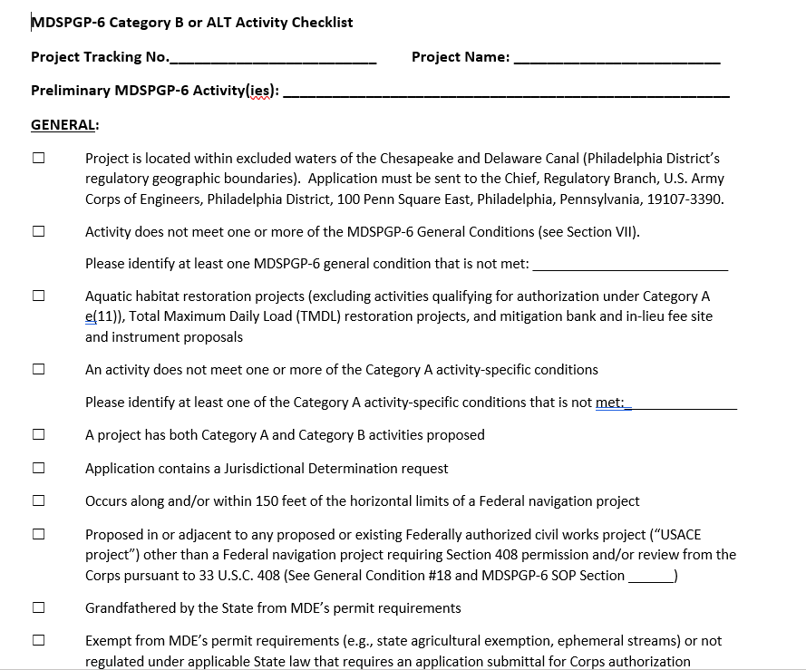
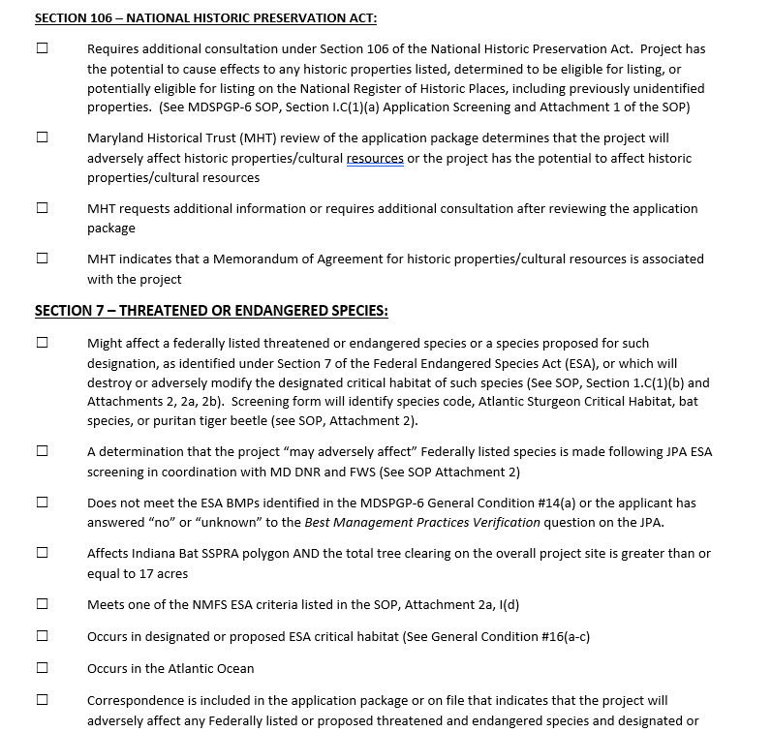

Slide 38
ATF Applications
MDSPGP-5:
All ATF applications sent to the Corps.
MDSPGP-6:
Corps will only receive ATF applications that would be CAT B.

Slide 39
Transmittal form
MDSPGP-5:
No MDE project manager listed on transmittal form. Corps would not know who to coordinate with at MDE.
MDSPGP-6:
MDE will add MDE PM to transmittal form.
Corps RPA will copy MDE PM when sending initial notification e-mail.
Corps PM will know who to coordinate with at MDE.

Slide 40
SELF-CERT form
MDSPGP-5:
Both Corps and MDE sent Self-Cert form with verifications.
MDSPGP-6:
MDE will no longer send Self Cert form.
Corps will no longer send the self-cert form, instead we will include a link to the form that applicants may use when required to report project completion.

Slide 41
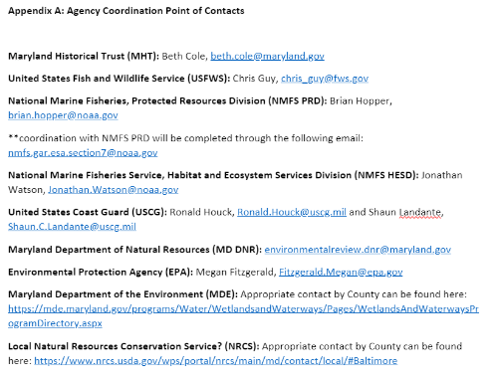
POC List
MDSPGP-5:
No available and current list of agency POCs.
MDSPGP-6:
Current list of agency POCs will be posted on Corps intranet.

Slide 42
Questions??

